Slide 1
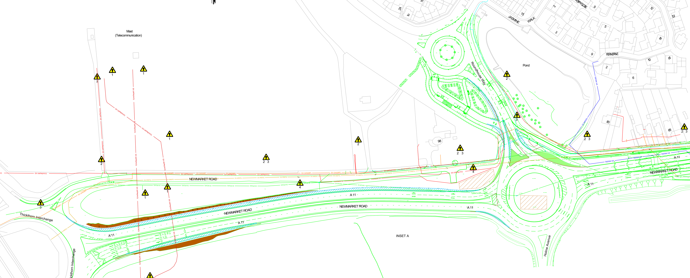





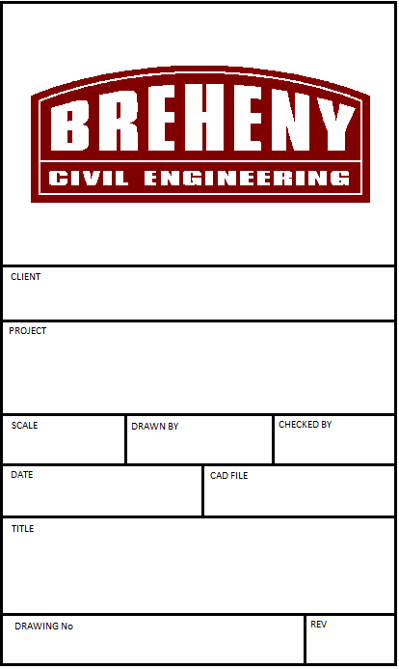


Eastbound Lane Overnight Closure
28/04 – 07/07
10 weeks
Nearside Lane Closure
Safety barrier installed
Safety barrier installed
Outside lane of
roundabout closed
Nearside Lane Closure
W/B overnight lane closure
28/04 – 29/05
4.4 weeks
WORK ACTIVITIES
A11 Newmarket Rd (Eastbound)
Site Clearance
Earthworks
Drainage (excluding tanks)
Ducting for traffic signals
Kerbs
Carriageway Widening
Newmarket Road
Widening
PHASE 1 - NIGHTTIME
KEY
N.T.S
C.D.C
S.L
A11 Newmarket Rd (Westbound)
Site Clearance
Earthworks
Drainage (excluding tanks)
Kerbs
Carriageway Widening
09-04-2024
Works Area
Newmarket Road
Widening
Phase 1
Traffic Flow
Safety Zone
05513-CC-P1

Slide 2

24/7 Lane closures on Rbt
5 weeks 17/03 to 22/04
Aquacell Tank
To be installed
Aquacell Tank
To be installed
Outside lane of
roundabout closed
Outside lane of
roundabout closed
WORK ACTIVITIES
A11 Newmarket Rd (Eastbound)
Drainage (Aqua Cell Tank North)
Newmarket Road
Widening
PHASE 1 - DAYTIME
A11 Newmarket Rd (Roundabout)
Drainage (Aqua Cell Tank)
Ducting for traffic signals
Grasscrete
N.T.S
C.D.C
S.L
KEY
09-04-2024
Works Area
Newmarket Road
Widening
Phase 1
Traffic Flow
Safety Zone
05513-CC-P1

Slide 3


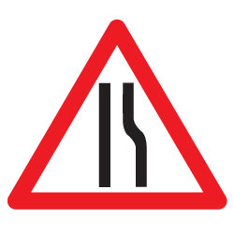
24/7 lane closures on Rbt
24/04 – 29/05
Also 1 week, night-time, one-way closure on Roundhouse Way to remove splitter island
Splitter Island Closed.
Footpath diversion route
Splitter Island Closed.
WORK ACTIVITIES
Roundhouse Way Roundabout (North Arm)
Break out northern splitter island &
install temp carriageway widening
Drainage
Kerb re-alignment
Ducting for traffic signals
Carriageway Widening
Newmarket Road
Widening
PHASE 2 - DAYTIME
KEY
N.T.S
C.D.C
S.L
09-04-2024
Works Area
Newmarket Road
Widening
Phase 2
Traffic Flow
Safety Zone
05513-CC-P2

Slide 4
24/7 lane closures to Rbt.
3.6 weeks 30/05 – 25/06
Bus stop temporarily closed &
Relocated to enable carriageway re-alignment
Temporary splitter island
Splitter Island Closed.
WORK ACTIVITIES
Roundhouse Way Roundabout (North Arm)
Site Clearance
Earthworks
Drainage
Ducting for traffic signals
Kerbs
Carriageway reconfiguration
Newmarket Road
Widening
PHASE 3 - DAYTIME
KEY
N.T.S
C.D.C
S.L
09-04-2024
Works Area
Newmarket Road
Widening
Phase 3
Traffic Flow
Safety Zone
05513-CC-P3

Slide 5
24/7 lane closures to Rbt
2.4 weeks 26/06 to 15/07
Splitter Island Closed.
Footpath diversion route
Splitter Island Closed.
WORK ACTIVITIES
Roundhouse Way Roundabout
(Splitter island North)
Drainage
Ducting for traffic signals
Kerbs
Splitter Island reconfiguration
Newmarket Road
Widening
PHASE 4 - DAYTIME
KEY
N.T.S
C.D.C
S.L
09-04-2024
Works Area
Newmarket Road
Widening
Phase 4
Traffic Flow
Safety Zone
05513-CC-P4

Slide 6

Overnight closures
2.0 weeks 14/07 – 04/08
WORK ACTIVITIES
Roundabout
Plane out\surface course
Road markings
Install Street lighting (By client)
Install traffic signals (by Client)
Signage
Splitter Island (West)
Kerbs
Splitter Island reconfiguration
Change streetlight lanterns (By Client)
Traffic Signals (By Client()
Newmarket Road
Widening
PHASE 5 – NIGHT TIME ROAD CLOSURE
KEY
N.T.S
C.D.C
S.L
09-04-2024
Works Area
Newmarket Road
Widening
Phase 5
Traffic Flow
Safety Zone
05513-CC-P5

Slide 7
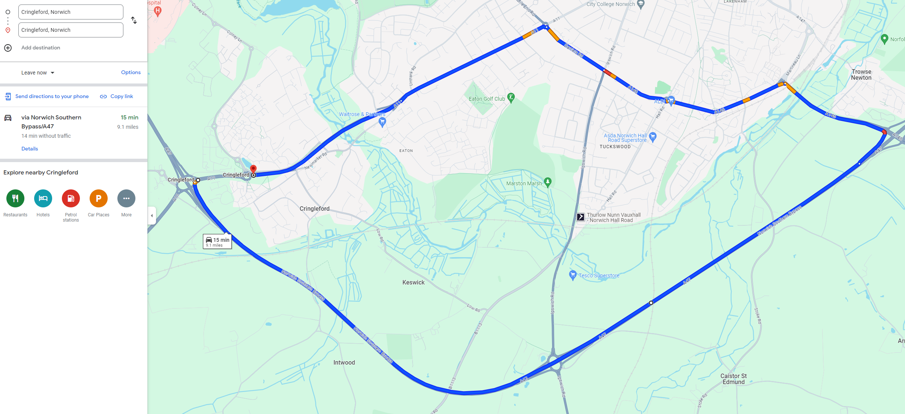
PHASE 5 – NIGHTTIME ROAD CLOSURE
POTENTIAL HGV DIVERSION ROUTE
15 MINUTES\9.1 MILES

Slide 8
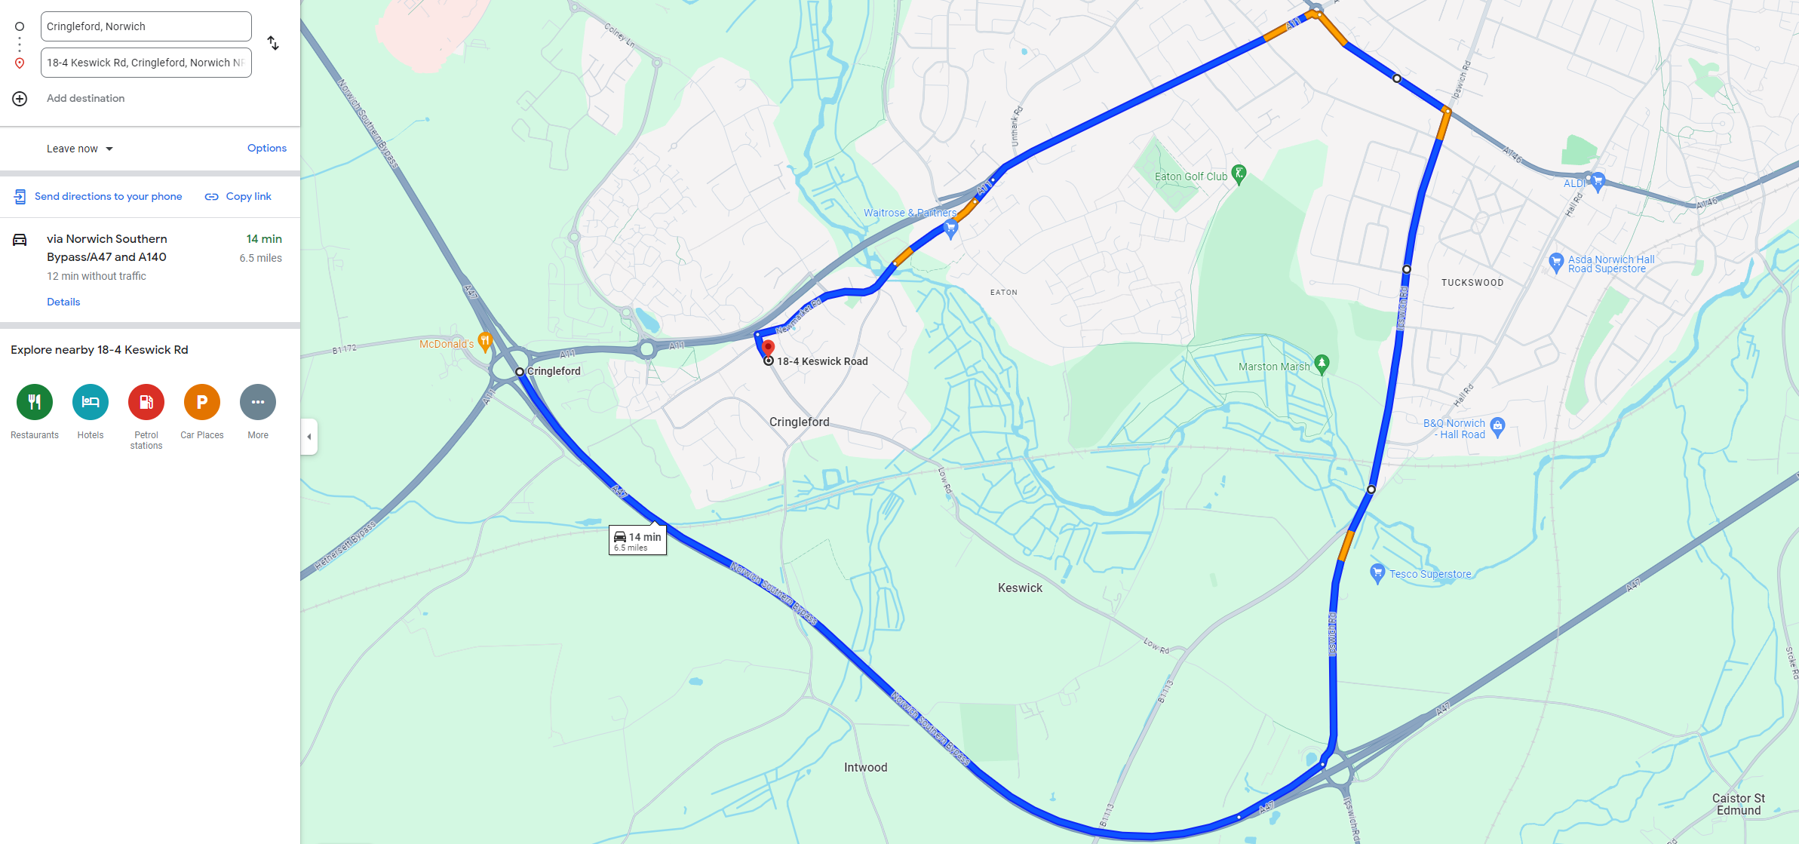
PHASE 5 – NIGHTTIME ROAD CLOSURE
POTENTIAL DIVERSION ROUTE A11 NEWMARKET (SOUTH)
14 MINUTES\6.5 MILES

Slide 9
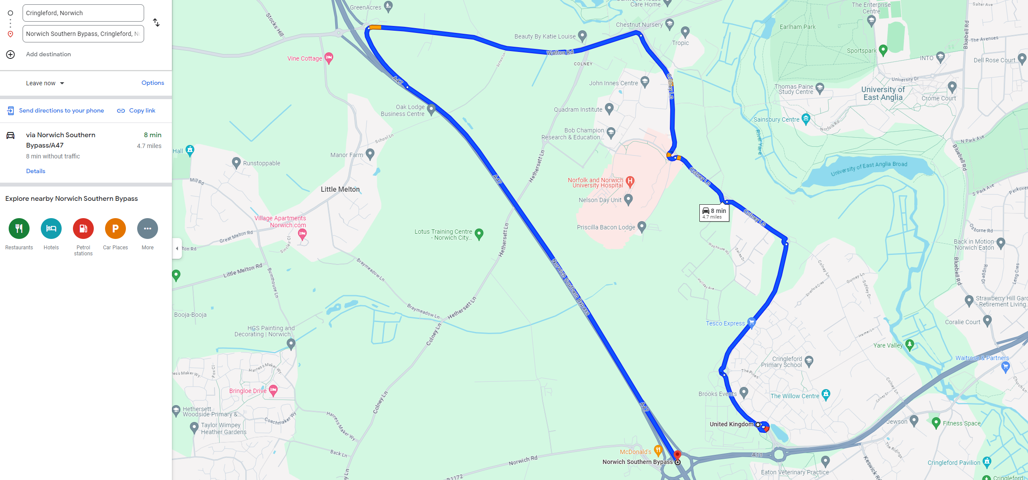
PHASE 5 – NIGHTTIME ROAD CLOSURE
POTENTIAL DIVERSION ROUTE A11 NEWMARKET (NORTH)
8 MINUTES\4.7 MILES

